Slide 1


Introduction to Python for Structural Dynamics
Miguel A. Gomez
(miguel.gomez.f@berkeley.edu)
University of California, Berkeley
September 2025

Slide 2
Introduction to python
General comments
Python is a general-purpose programming language. A piece of python code is basically a series of instructions that the computer follows, sequentially.
However, a simple python distribution will not be enough for most computing tasks.
We will need to install and load some modules, at the beginning of our program, that will allow us to do numerical computations and generate plots:
numpy: to enable vector and matrix (array) computations.
matplotlib: to enable plotting capabilities.
To get the most out of any programming language, it’s always useful to know how to work with functions.
Through this sessions we’ll be using AI tools for coding. The goal of this session is that we can properly interpret the code that is being generated, and how to write effective prompts that produce the desired results.
For more general purposes, python also allows object-oriented programming (classes), but we won’t cover those here (questions about this in OH).

Slide 3
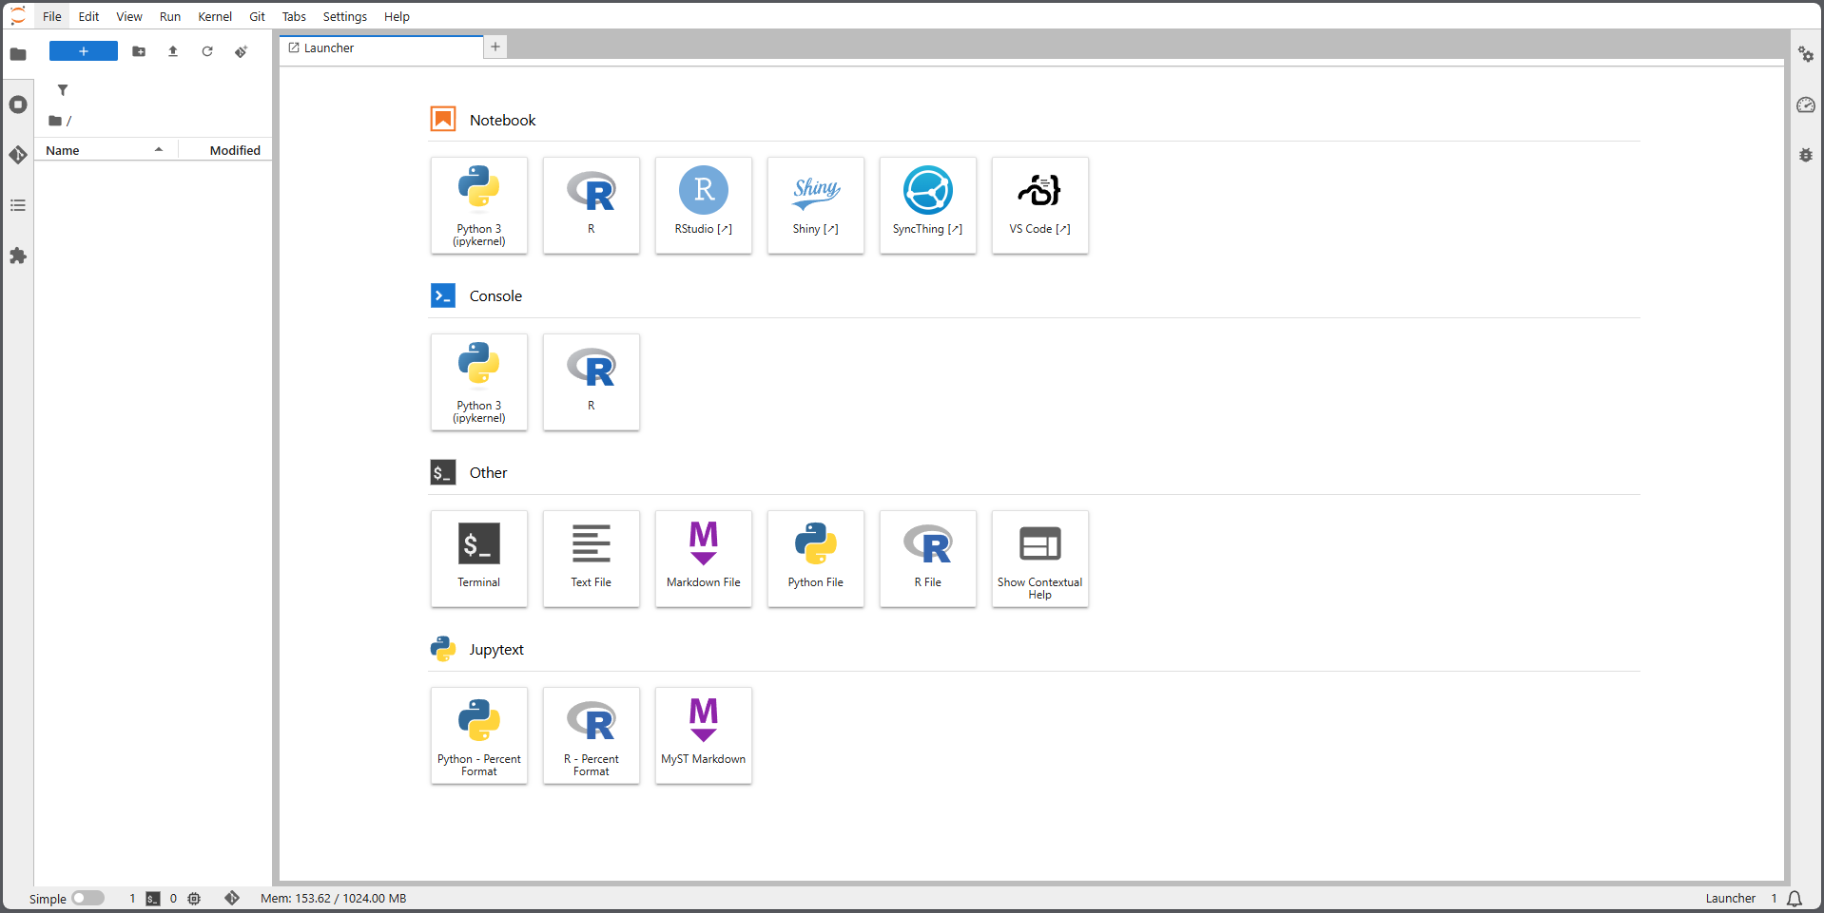
Introduction to python
UC Berkeley DataHub
UC Berkeley provides all students access to Jupyter Notebooks through DataHub. Check that you have access by visiting this website:
https://datahub.berkeley.edu/hub/login
You’ll be requested to access with you CalCentral credentials.

Slide 4
Introduction to python
Basic data structures
Python comes with the following data structures:
# Numeric types
int_var = 10 # integer
float_var = 3.14 # floating-point number
complex_var = 2 + 3j # complex number
# Sequence types
list_var = [1, 2, 3] # list (mutable)
tuple_var = (1, 2, 3) # tuple (immutable)
range_var = range(5) # range object
# Text type str_var = "Hello, Python" # string
# Set types set_var = {1, 2, 3} # set (unique unordered)
frozenset_var = frozenset([1, 2, 3]) # immutable set
# Mapping type
dict_var = {"a": 1, "b": 2} # dictionary (key-value pairs)
# Boolean bool_var = True # True or False
# None type none_var = None # null equivalent

Slide 5
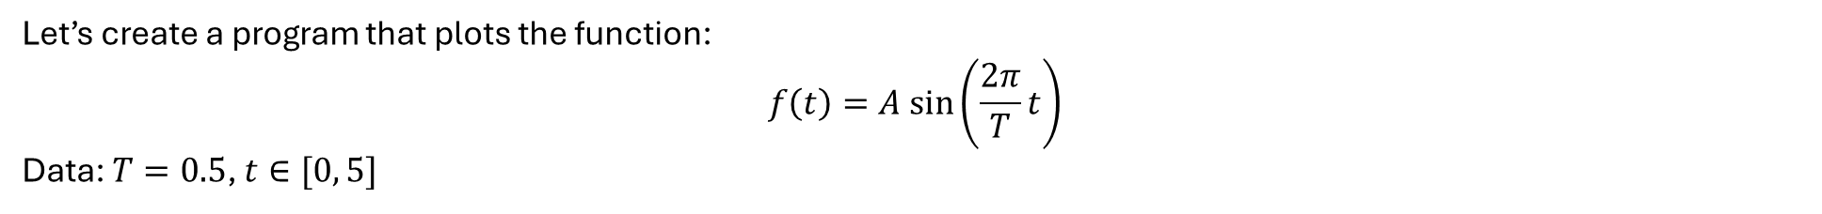
Introduction to python
Example
Let’s create a program that plots the function:
$$f\left(t\right)=A sin\left(\frac{2π}{T}t\right)$$
Data: $T=0.5$, $t∈[0, 5]$

Slide 6
Introduction to python
Example
Typically, I set up a Jupyter notebook with 4 cells:

